Slide 1

ENVIRONMENTAL REVIEW PETITION PROCESS
Denise Wilson| Director, Environmental Review Program
Randall Doneen | Conservation Assistance and Regulation Section Manager

Slide 2
Environmental Review Program Purpose
Disclose environmental information and describe potential impacts
Lead to voluntary/required modifications, permit conditions or agreements
Accountability in public and private decision making
Provide public with access to decision makers

Slide 3
Environmental Review Program characteristics
Broader in scope than permitting
Moratorium on all “final approvals” and construction
Projects do not pass or fail environmental review – not an approval process
Informs project designers early in process
Opportunity for citizens to petition their government

Slide 4
Environmental Review Petition Process
MS 116D.04 subd. 2a/MR 4410.1100
A standardized process for citizens to raise concerns about a proposed project
Must provide material evidence and 100 signatures
Decision on the need to prepare an Environmental Assessment Worksheet
Decisions can be appealed (MS 116D.04 subd.10)

Slide 5
Citizen Petition Process: EQB’s Role (MR 4410.1100)
Subpart 1: Review
Subpart 2: Content
Subpart 5: RGU Selection
Any Person
100 Signatures and addresses
Reside/own in MN
Description of project
Proposer
Rep. of the petitioners
Brief description of the potential environmental effects
Verify material evidence submitted
Use 4410.0500
Mandatory Category
State Agency is the Proposer
Governmental unit with the greatest responsibility for supervising or approving the project as a whole
5-days

Slide 6
Citizen Petition Process: RGU’s Role (MR 4410.1100)
Subpart 6: EAW decision
Subpart 8: Notice of decision
Evaluate material evidence presented by the petitioners, proposers, and other persons or otherwise known to the RGU
Demonstrates- nature and location-may have potential for significance
Take into account MR 4410.1700 criteria
Subpart 7: Time limits
Decide on the need for an EAW
Notice of decision to Proposer, EQB, Citizen Rep.
15-days
5-days
MS 116D subdiv. 17: DNR and PCA must notify project proposer 14 days ahead of decision

Slide 7
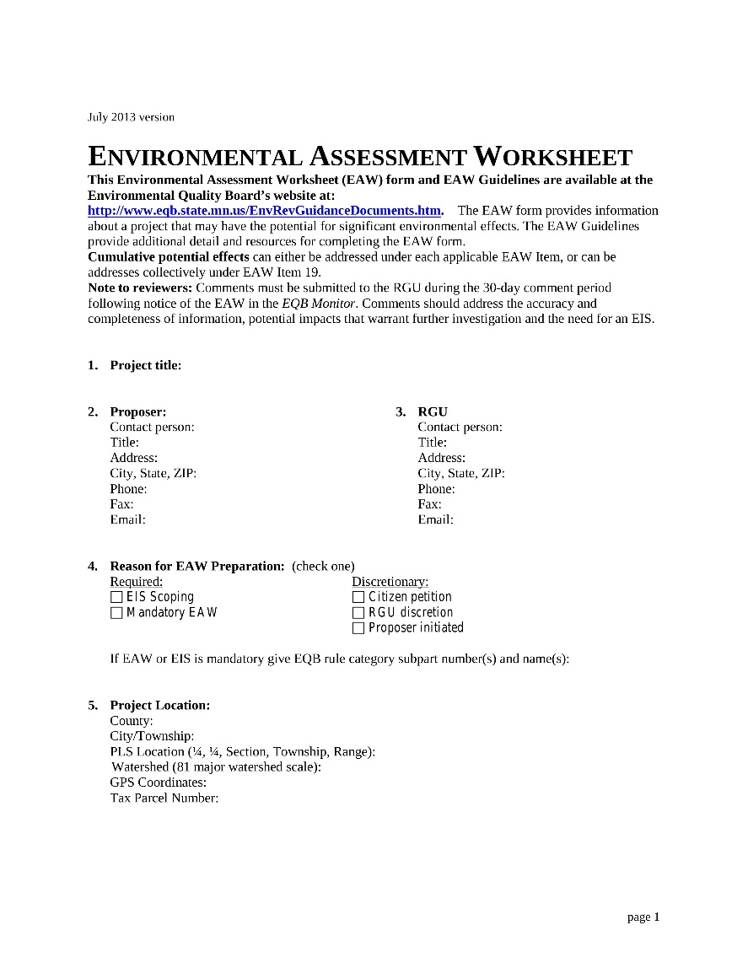
EAW – Environmental Assessment Worksheet
6-page worksheet
20 standardized questions
Discloses information necessary to decide if an EIS is needed
https://www.eqb.state.mn.us/content/eaw-process

Slide 8
EAW process (MR 4410.1000-1700)
Determination date noticed in Monitor
First environmental review discussions
Complete data submittal
EAW noticed in Monitor
RGU notifies proposer
Pre-submittal discussions
RGU reviews data
RGU notifies proposer
RGU supplements and approves
EAW
RGU sends EAW to EQB
30-day comment period
RGU
prepares EIS Need Decision
(30 days)
(5 days)
(30 days)
(5 days)
(30 days)
(15-30 days)
Data submittal
Consider MR 4410.1700 Decision Criteria

Slide 9
Petitions

Slide 10
Resources and assistance
Written guidance documents:
  Rules
  Guide to MN Environmental Review Rules
  EAW Guidelines
  Guides for citizens and local govt. units
  AUAR guidance document
  Distribution Lists
  EQB Monitor – current issue and archives
Technical Assistance:
  Email: Env.Review@state.mn.us
  Phone: 651-757-2873
Videos:
  Minnesota Environmental Review Program
  The Environmental Assessment Worksheet - Guidance Video
  Guide to the Citizen Petition Process - Environmental Review
Available at: www.EQB.State.MN.US

Slide 11
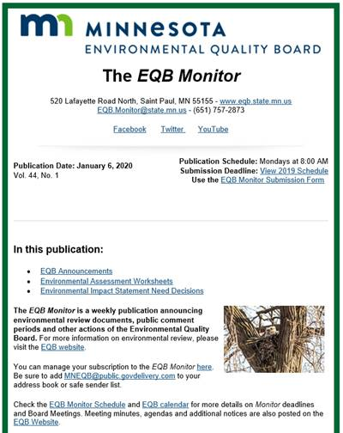
EQB Monitor
Weekly publication announcing:
Environmental review documents
Public comment periods; public meetings
Other actions of the Environmental Quality Board.
To sign up: https://public.govdelivery.com/accounts/MNEQB/subscriber/new?preferences=true

Slide 12

Thank You!
Denise Wilson
Denise.Wilson@state.mn.us
651-757-2523
Randall Doneen
randall.doneen@state.mn.us
651-259-5156

